Slide 1
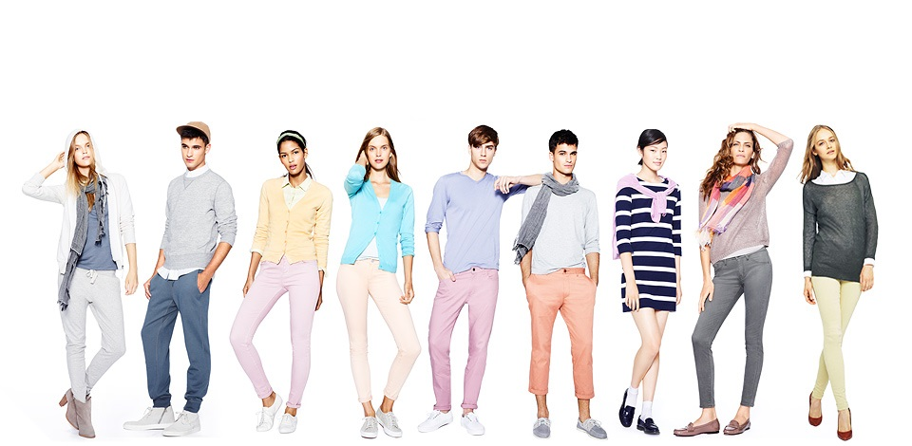
Clothes – Wearing habit
Nhóm 1: - Trần Nô
- Hải Anh
Speaking test – 29/10/2016

Slide 2
Clothes – Wearing habit
1. NEW WORDS
2. QUESTIONS
3. ANSWERS

Slide 3
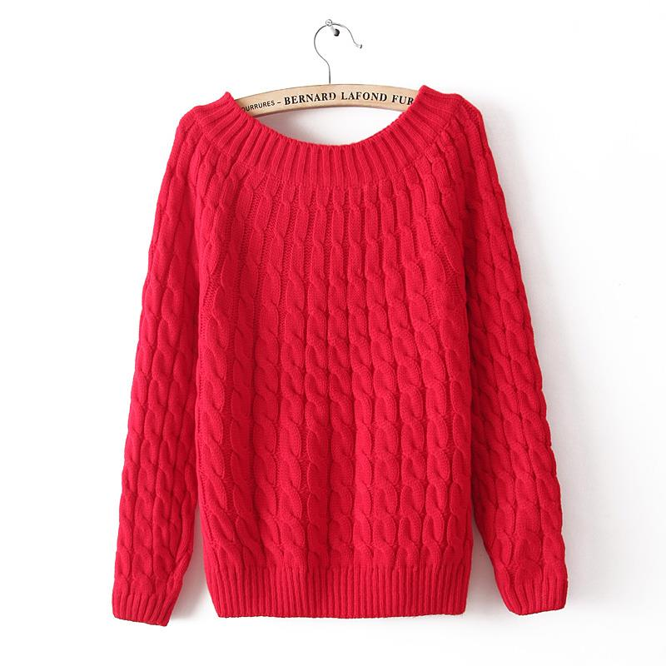
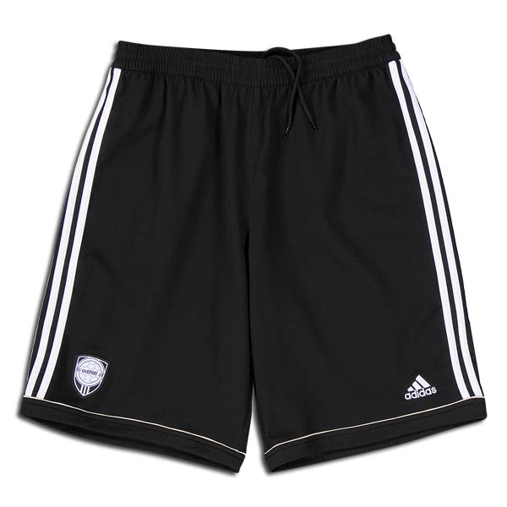
Shorts
Sweater

Slide 4
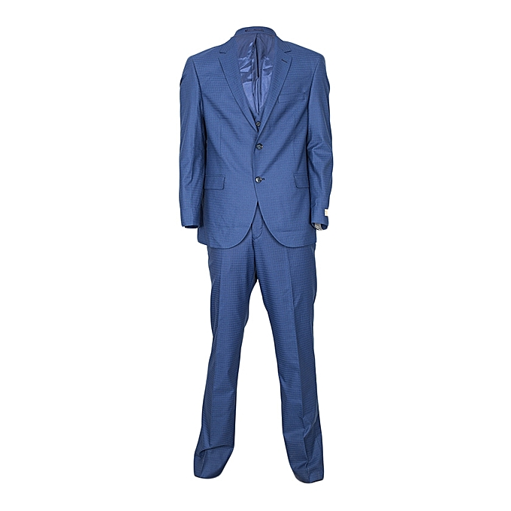
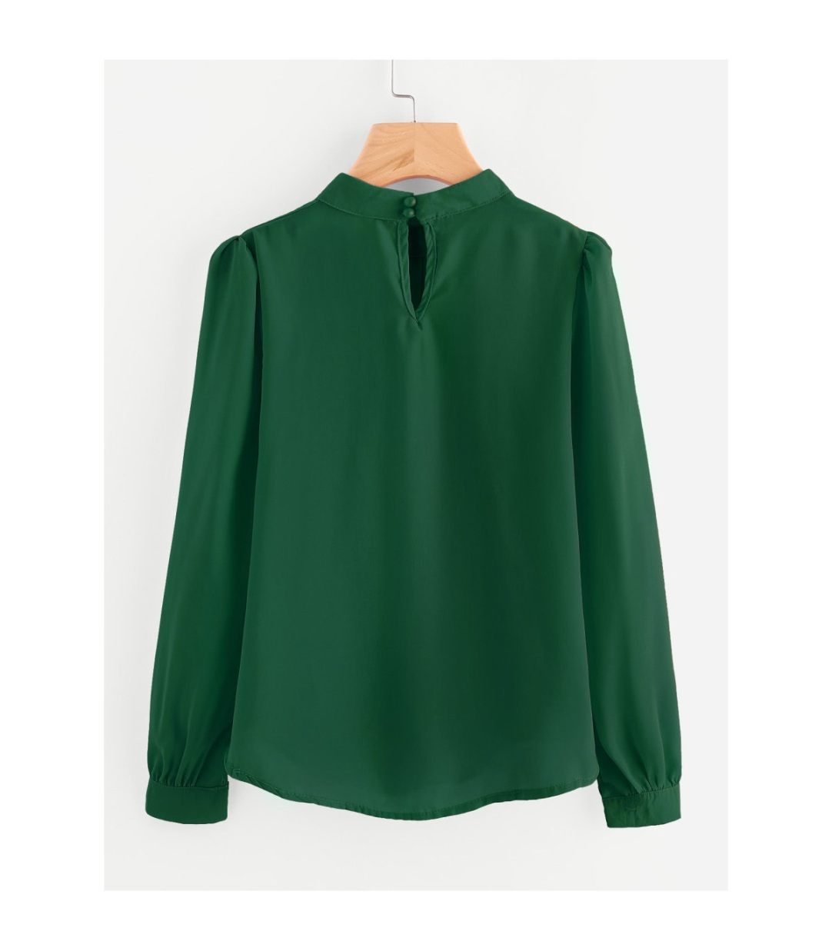
Blouse: áo sơ mi kiểu
Suit: đồ vest

Slide 5
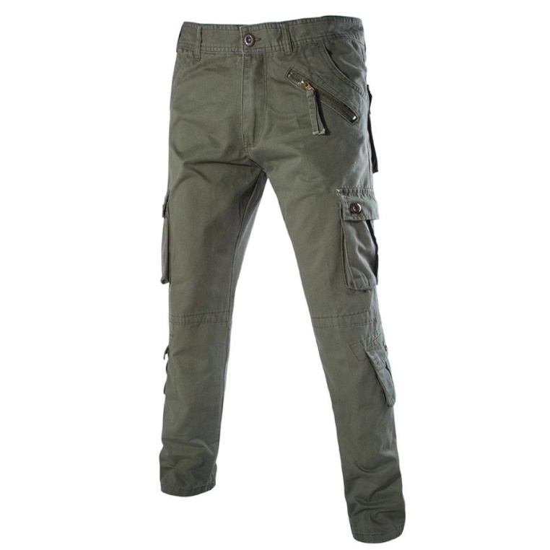
Pants
(Quần dài)

Slide 6
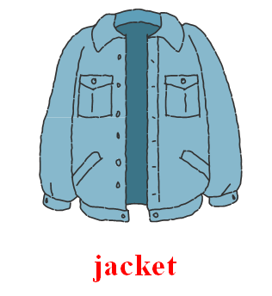
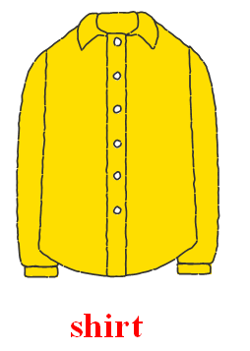
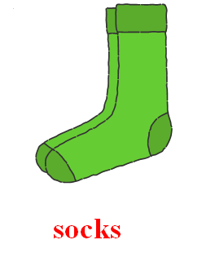
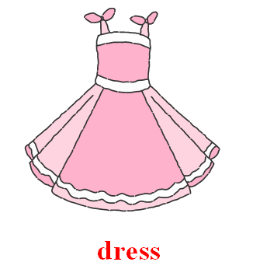
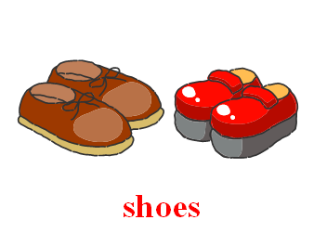
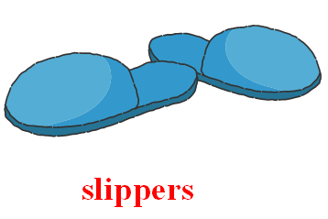

Slide 7
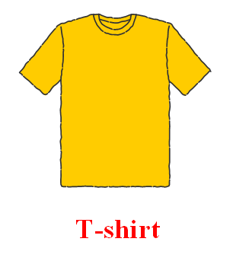
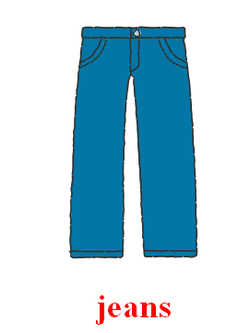
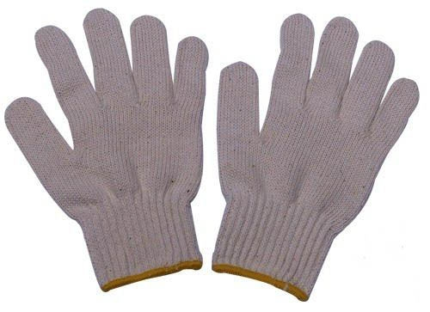
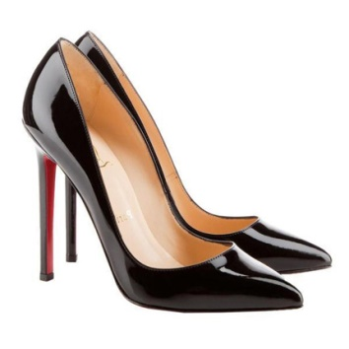
High heel
Glove

Slide 8
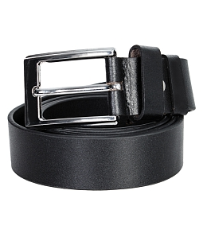
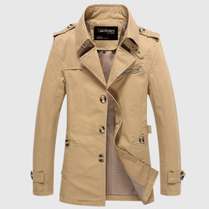
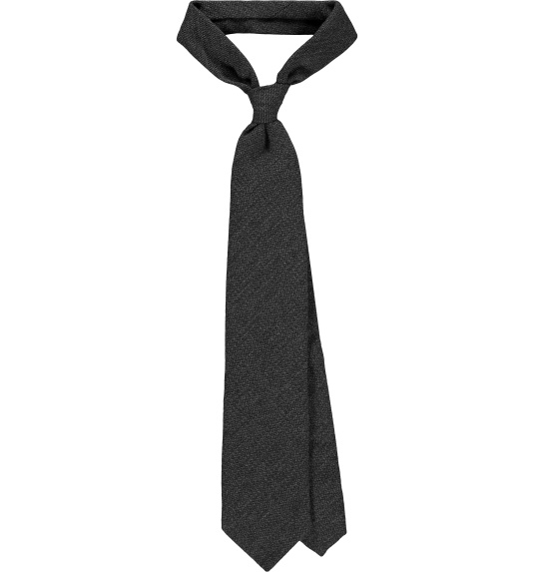
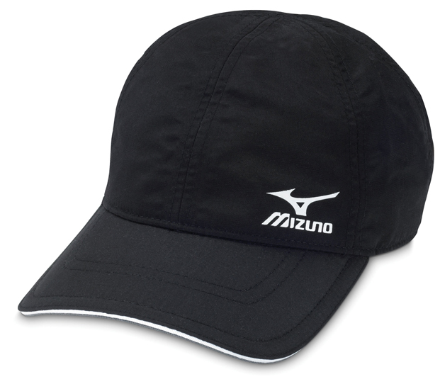
Tie
Belt
Coat
Cap

Slide 9
Formal/ informal
Trousers : quần tây, quần âu

Slide 10
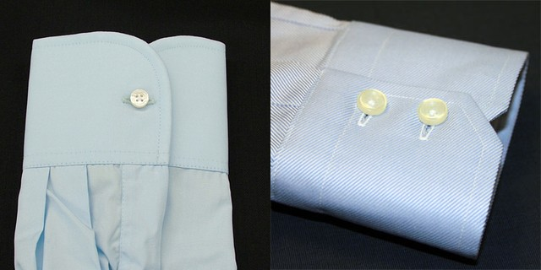
sleeve (n): tay áo
sleeveless (a): không có tay
short-sleeved (a): tay ngắn
Long-sleeved shirt: áo thun dài tay

Slide 11
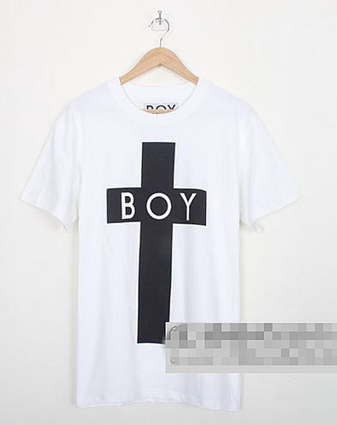
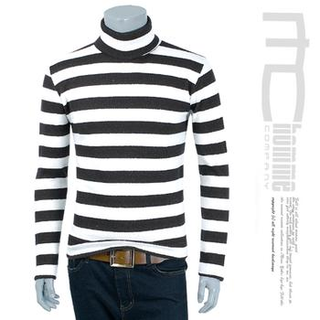
PATTERN: HOA VAN
Cross
(Chữ thập)
Stripe
(sọc)

Slide 12
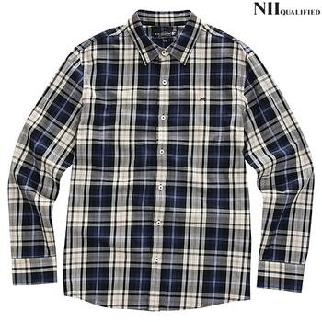
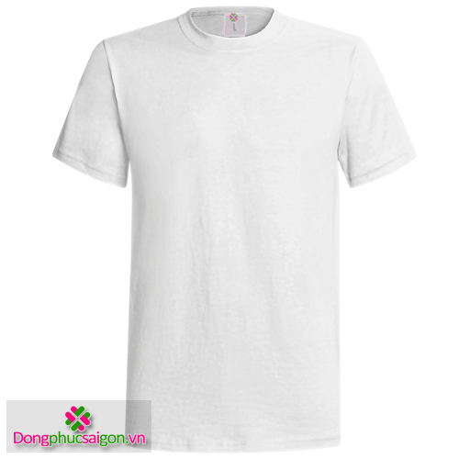
Plaid
(Carô)
PLAIN
(Trơn)

Slide 13
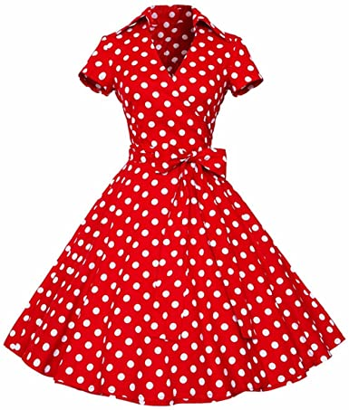
POLKA DOT

Slide 14
silk (n): lụa
tunic (n): tà áo
slit (v): xẻ
loose (a): lỏng, rộng
fashion designer nhà thiết kế thời trang
material (n): vật liệu
symbol (n): ký hiệu, biểu tượng
symbolize (v): tượng trưng
baggy (a): rộng thùng thình
faded (a): phai màu
casual clothes (n): quần áo thông thường
cloth (n): vải
wear out mòn, rách
embroider (v): thêu
label (n): nhãn hiệu
Pocket : túi áo

Slide 15


Slide 16
Keyword
It’s a shirt
Đó là một chiếc áo sơ mi
- They are jeans
Đó là chiếc quần jean - It’s a jacket
Đó là một chiếc áo khoác - They are stockings
Đó là chiếc quần tất - It’s a T-shirt
Đó là một chiếc áo phông - They are socks
Đó là đôi tất - It’s a skirt
Đó là một chiếc váy - They are shoes
Đó là một đôi giày - It’s a sweater
Đó là một chiếc áo len
- They are slippers
Đó là đôi dép lê

Slide 17
Frequently asked
Questions

Slide 18

Styles/Types of Clothes
- What kinds/styles of clothes do you like wearing? (Why?)
- What kind of clothes do you like best? (Why?)
- What kinds of clothes do you usually wear?
- What kinds of (or, style of) clothes do people in your country like wearing?

Slide 19
Fashion
- Are you very interested in fashion (or, clothes fashions)?
- What do you think of (or, about) fashion?
- What do you think about fashion nowadays in your country?
- What kinds of clothes are popular in Vietnam?

Slide 20
Different People Wearing Different Clothes
- Do students and working people wear the same kinds of clothes?
- What can you learn about a person from the clothes they wear?

Slide 21
Shopping for Clothes
- How often do you go shopping for clothes?
- Do you like shopping (for clothes)? (Why?/Why not?)
- Is shopping for clothes important to you?
- Do you spend a lot of money on clothes?
- Where do you buy your clothes?
The Colour of Clothes
- What's your favourite clothes colour? (Why?)
- When you buy clothes, how do you choose the colour?

Slide 22
Answers the questions

Slide 23
1) What kinds/styles of clothes do you like (or, prefer) to wear? (Why?)
I like…(natural style, office style,….) because ……(It makes me comfortable)
2) What kinds of clothes are popular in Vietnam?
Vietnamese people wearing a variety of clothes
3) What can you learn about a person from the clothes they wear?
I can know their character, their life….
How often do you go shopping for clothes?
I go shopping twice a week/ twice a month….
5) What's your favourite clothes colour? (Why?)
→ I like pink so when I buy clothes I usually buy a pink clothes….

Slide 24


